Slide 1
SQA

Slide 2
Deficiencies in software quality often results
In costly emergency fixes
Damage to a brand’s reputation, software company defaulters–large repayments
Software defects are extremely costly in term of
Money
Loss of life
Reputation

Slide 3
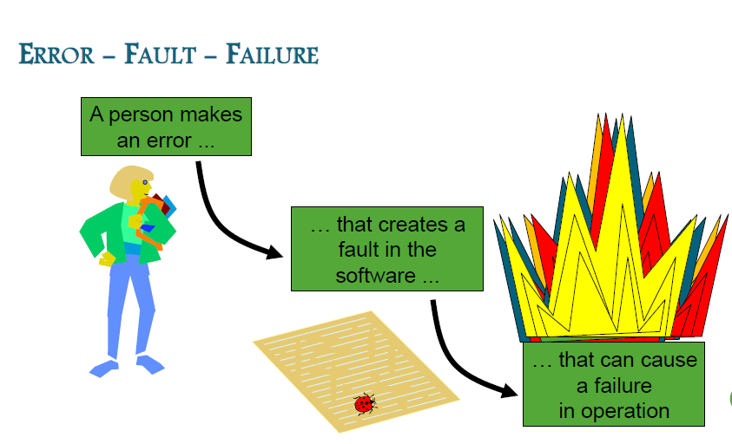

Slide 4
SOME FAMOUS SOFTWARE ERRORS
Therac-25
Patriot Missile System
NASA's Mars Polar Lander
ESA's Ariane5 Launch System
2003 Blackout

Slide 5
Standish Group Chaos Report

Slide 6
Standish Group Chaos Report (2007)
35%of all software projects are now completed successful (1995: 16.2 %)
19% of projects fail (1995: 31.1%)
46%where described as challenged, meaning they had cost or time overruns or didn’t fully meet the user’s needs (1995: 52.7%)

Slide 7
What Is Quality?
Experts define quality based on:
Conformance to requirements: The project’s processes and products meet written specifications.
Fitness for use: A product can be used as it was intended.

Slide 8
What is Quality
In general, people’s quality expectations for software system they use and rely upon are two-fold:
The software systems must do what they are supposed to do. In other words, they must do the right things.
They must perform these specific tasks correctly or satisfactorily. In other words, they must do the things right.
Now you can define Software Quality Assurance.

Slide 9
What is quality?
Quality refers to any measurable characteristics such as correctness, maintainability, portability, testability, usability, reliability, efficiency, integrity, reusability and interoperability.

Slide 10
What is SQA?
Software Quality Assurance is an umbrella activity that is applied throughout the software process...

Slide 11
Importance of SQA
Due to the widespread acceptance, and use of software systems software bugs are proving to be costly, and sometimes fatal.
It is estimated that buggy or flawed software cost businesses $175 billion worldwide in 2001.
Bugs have affected banking systems, stock exchanges, medical institutions, educational institutions and even the Social Security Administration

Slide 12
Importance of SQA
Most bugs, encountered during software development,
can be avoided,
by adopting a sound software development process,
and
having strict software quality control using Software Quality Assurance

Slide 13
Software Quality Assurance
VS
Software Testing

Slide 14
SQA vs. Software Testing
Software Testing involves operating a system, or an application, under controlled conditions, and evaluating the results.
Software testing is normally carried out under controlled conditions
The aim of testing is to try to break the software, and find the bugs in it.
Testing is oriented towards "detection "of bugs in the software

Slide 15
SQA vs. Software Testing
SQA is aimed at Avoiding Bugs.
Software Quality Assurance is oriented towards "prevention "of bugs in the software, by following a software development methodology.
SQA is more concerned with developing a quality process for software development, which will prevent the generation of bugs, and will result in the production of quality software

Slide 16
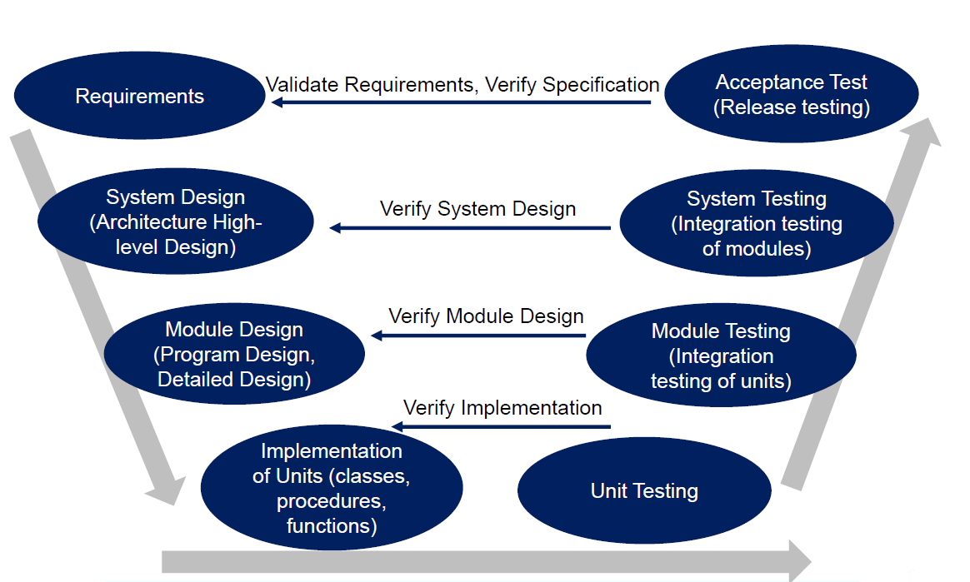
SQA vs. Software Testing
Maintenance

Slide 17
SQA vs. Software Testing
Maintenance
Software Quality Assurance
Software Testing

Slide 18
Elements of S/W Quality Assurance
Standards (ISO 9001, CMMI)
Reviews and audits
Testing
Error/defect collection and analysis
Change management
Education
Vendor management
Security management
Safety
Risk management

Slide 19
SQA tasks
Prepares an SQA plan for a project
Participates in the development of the project’s software process description
Reviews software engineering activities to verify compliance with the defined software process
Audits designated software work products to verify compliance with those defined as part of the software process
Ensures that deviations in software work and work products are documented and handled according to a documented procedure
Records any noncompliance and reports to senior management
Notes:
Make a quality plan – Create a plan to ensure software quality in a project.
Help define the software process – Be involved in setting up how the software will be developed and managed.
Review work to check if rules are followed – Go through activities to make sure they follow the planned process.
Audit work products – Check completed work to ensure it matches the defined process.
Handle deviations (errors or issues) – Make sure any mistakes or differences from the process are documented and fixed properly.
Report problems – Record any issues and inform higher management.

Slide 20
SQA plan
Management section
describes the place of SQA in the structure of the organization
Documentation section
describes each work product produced as part of the software process
Standards, practices, and conventions section
lists all applicable standards/practices applied during the software process and any metrics to be collected as part of the software engineering work
Reviews and audits section
provides an overview of the approach used in the reviews and audits to be conducted during the project

Slide 21
SQA plan
Test section
references the test plan and procedure document and defines test record keeping requirements
Problem reporting and corrective action section
defines procedures for reporting, tracking, and resolving errors or defects, identifies organizational responsibilities for these activities
Other
tools, SQA methods, change control, record keeping, training, and risk management

Slide 22
Statistical SQA
Information about software defects are collected and categorized
An attempt is made to trace each defect to its underlying cause
Isolate the vital few causes of the major source of all errors
Then move to correct the problems that have caused the defects
Severity level

Slide 23
Reviews →To uncover errors/defects
To uncover errors in function, logic, or implementation for any representation of the software
To verify that software meets its requirements
To ensure that software representation meets predefined standards
To achieve software development in a uniform manner
To make projects more manageable

Slide 24
Why do peer reviews?
To improve quality.
Catches 80% of all errors if done properly.
Catches both coding errors and design errors.
Enforce the spirit of any organization standards.
Training and insurance.

Slide 25
Review Guidelines..
Review the product, not producer
Set an agenda and maintain it
Limit the debate
Enunciate problem areas, not to solve every problem noted
Take written notes
Allocate resources and time schedule for FTR’s
Use standards to avoid style disagreements.
Let the coordinator run the meeting and maintain order.
Limit the number of participants and insist upon advance preparation
Develop a checklist for each work product to be reviewed
Training for all reviewer’s
Reviewing earlier reviews Keep it short (< 30 minutes).
Don’t schedule two in a row.
Don’t review product fragments.

Slide 26
Effectiveness of review → Defect Amplification and Removal
Used to illustrate the generation and detection of errors during design and code generation
Development step
Defects
Detection
Errors passed through
Percent efficiency for error detection
Errors from previous steps
Amplified errors 1:x
Errors passed to next step
Newly identified errors

Slide 27
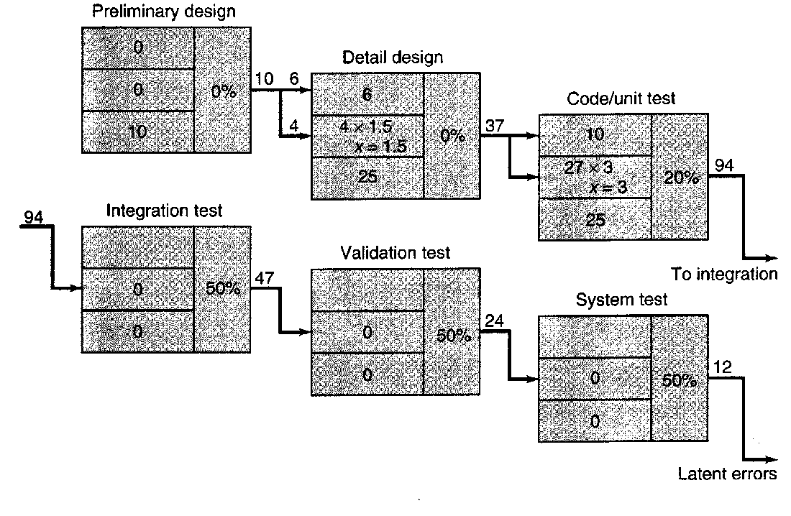
Effectiveness of review → Defect Amplification and Removal
No reviews

Slide 28

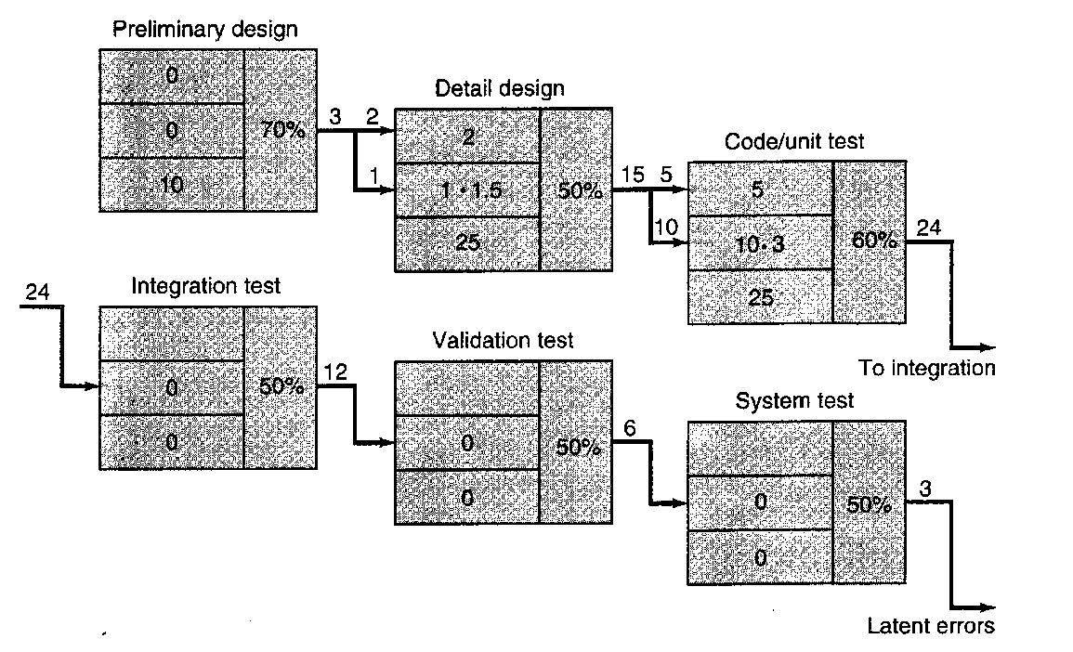
Effectiveness of review → Defect Amplification and Removal
With reviews

Slide 29
Effectiveness of review → Defect Amplification and Removal
No reviews
With reviews
Notes:
Left Side: No Reviews
Defects are not caught early.
Errors from the early stages (like design) pass to later stages (like testing).
As work progresses, defects keep growing (amplifying).
Final stage (System Test) still has 12 latent (hidden) defects.
94 defects entered testing = very high.
✅ Right Side: With Reviews
Each phase is reviewed, so defects are caught early.
Fewer defects move to the next phase.
Final stage has only 3 latent defects.
Only 24 defects entered testing = much better.

Slide 30
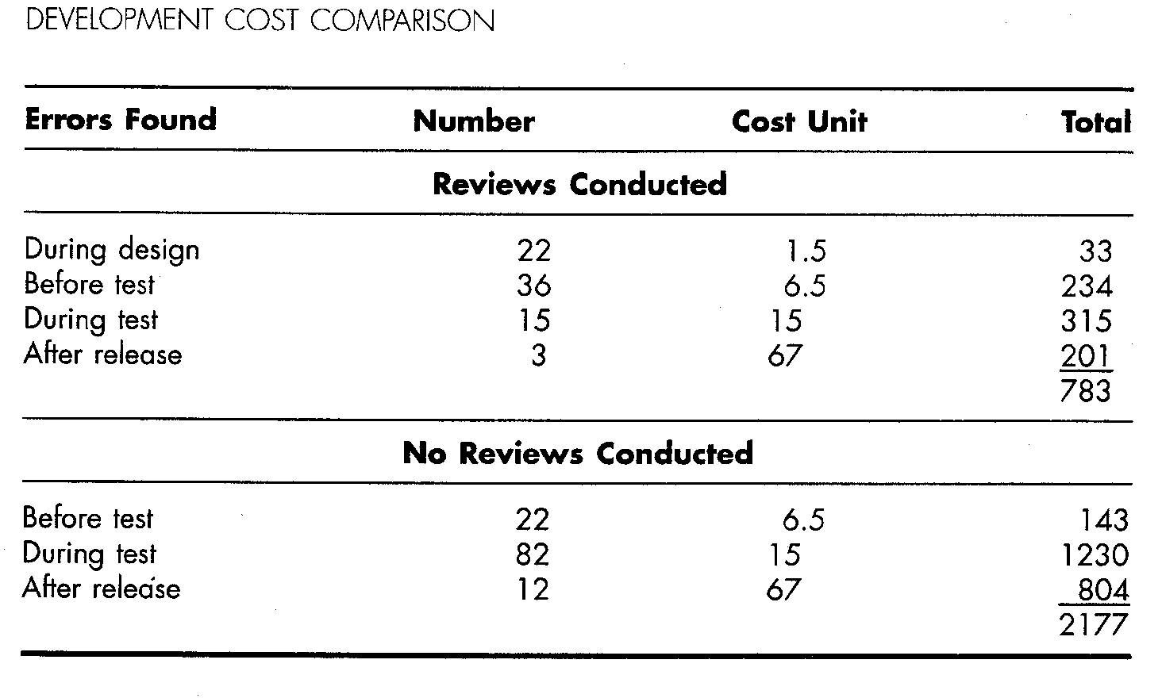
Effectiveness of review → Defect Amplification and Removal

Slide 31
Review metrics and their use
Many metrics can be defined for technical reviews
The following can be calculated for each review conducted:
Preparation effort (E_{p})
Assessment effort (E_{a})
Rework effort (E_{r})
Work product size (WPS)
Minor errors found (Err_{minor})
Major errors found (Err_{major})
Notes:
. Preparation Effort (Ep)
Time spent getting ready for the review.
🧠 Example: Ali reads and understands the code before a review meeting. He spends 2 hours doing that. ➡️ Ep = 2 hours
👀 2. Assessment Effort (Ea)
Time spent actually doing the review.
🧠 Example: The review meeting takes 3 hours where the team checks the work and finds issues. ➡️ Ea = 3 hours
🔁 3. Rework Effort (Er)
Time spent fixing the problems found in the review.
🧠 Example: After the review, Zara fixes bugs and it takes her 4 hours. ➡️ Er = 4 hours
📦 4. Work Product Size (WPS)
Size of the document or code being reviewed. Usually measured in lines of code (LOC) or pages.
🧠 Example: The team reviews a document that is 100 lines of code. ➡️ WPS = 100 LOC
⚠️ 5. Minor Errors Found (Errₘᵢₙₒᵣ)
Small mistakes that don’t affect functionality much (e.g., typos, naming issues).
🧠 Example: During the review, 5 small mistakes were found. ➡️ Errₘᵢₙₒᵣ = 5
❗6. Major Errors Found (Errₘₐⱼₒᵣ)
Serious mistakes that can break the system or cause wrong results.
🧠 Example: The review finds 2 critical bugs in the logic. ➡️ Errₘₐⱼₒᵣ = 2

Slide 32
Analyzing review metrics
Total review effort (E_{review})
E_{review} = E_{p} + E_{a} + E_{r}
Total number of errors (Err_{tot})
Err_{tot} = Err_{minor} + Err_{major}
Error density represents the errors found per unit of work product reviewed
Error density = Err_{tot} / WPS (work product size)
Cost effectiveness of reviews
Effort saved per error = E_{testing} – E_{reviews}

Slide 33
Software reliability
Defined as the probability of failure free operation of a computer program in a specified environment for a specified time.
Can be measured directly and estimated using historical and developmental data (unlike many other software quality factors)
Software reliability problems can usually be traced back to errors in design or implementation.
Reliability metrics are units of measure for system reliability
System reliability is measured by counting the number of operational failures and relating these to demands made on the system at the time of failure
A long-term measurement program is required to assess the reliability of critical systems

Slide 34
Measuring S/W reliability
A measure of software reliability is mean time between failures where
MTBF = MTTF + MTTR
MTTF = mean time to failure
MTTR = mean time to repair
Availability =MTTF/(MTTF + MTTR) * 100%
Software availability is the probability that a program is operating according to requirements at a given point in time
Notes:
Software availability means:
How likely is the software running properly at any random point in time?

Slide 35
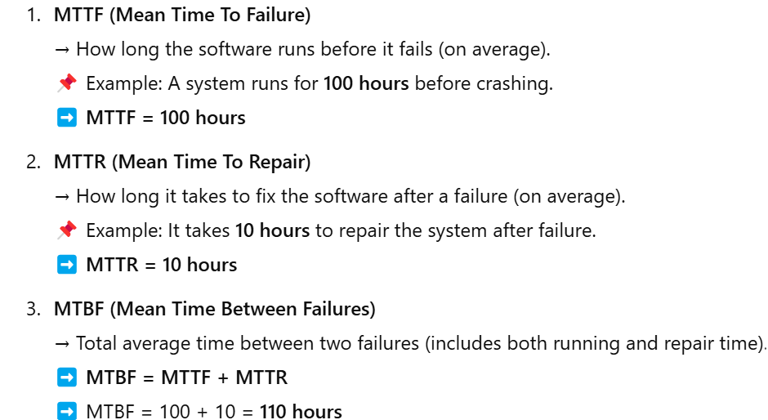
Example:

Slide 36
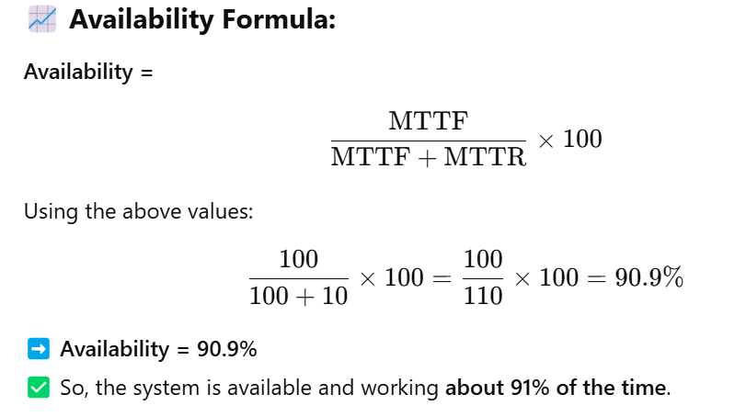
Cont…

